Slide 1
The impact of re-do Endoscopic Sleeve Gastroplasty for insufficient weight loss, weight plateau and weight regain
Loredana Gualtieri,
Giorgio Carlino, Valerio Pontecorvi,
Maria Valeria Matteo, Martina De Siena,
Cristiano Spada, Ivo Boskoski, Vincenzo Bove
Digestive Endoscopy Unit,
Fondazione Policlinico Universitario Agostino Gemelli IRCCS, Rome, Italy

Slide 2
Conflict of interest disclosure (COI)
I have no potential conflict of interest to report

Slide 3
BACKGROUND
Endocrine imbalances
Excessive calorie intake
Genetic factors
Physical inactivity
Mental health
Sleep deprivation
Familiar factors
Endocrine imbalances
Notes:
We know obesity is a multifactorial, chronic and relapsing disease, associated with poor life expectancy, high mortality rate and a significantly increased risk of health complications, including, but not limited to, cardiovascular diseases, metabolic disorders (e.g. type 2 diabetes, dyslipidemia), certain types of cancer, respiratory problems and osteoarticular morbid conditions.

Slide 4
OBESITY TEAM
Surgeon
Endocrinologist
Psychiatrist/
Psycologist
Endoscopist
Dietitian
GOALS
Notes:
Since it is a chronic disease, class III obesity typically requires a multidisciplinary approach and comprehensive treatment strategies, including lifestyle and behavioral changes, dietary interventions, physical activity, pharmacotherapy and more invasive treatment like surgery.
Bariatric and metabolic surgery has been extensively documented to result in significant and durable weight loss:

Slide 5
BARIATRIC SURGERY
1%
NO TREATMENT
NON-SURGICAL TREATMENT
MORBID OBESE
S
I
TY
99%
Ponce J, Nguyen NT, Hutter M, Sudan R, Morton JM. American Society for Metabolic and Bariatric Surgery estimation of bariatric surgery procedures in the United States, 2011-2014. Surg Obes Relat Dis 2015;11(6):1199–200.
Notes:
Nevertheless, patients undergoing bariatric surgery represent a small subset of those who are eligible for such procedures, often due to preferences and fears of patients and misconceptions about the risks and benefits of surgery. Less than 1% of obese individuals who meet the criteria for bariatric surgical intervention proceed with surgery . This discrepancy underscores a significant gap in the treatment landscape, where the majority of qualified candidates do not receive this potentially life-altering treatment.

Slide 6
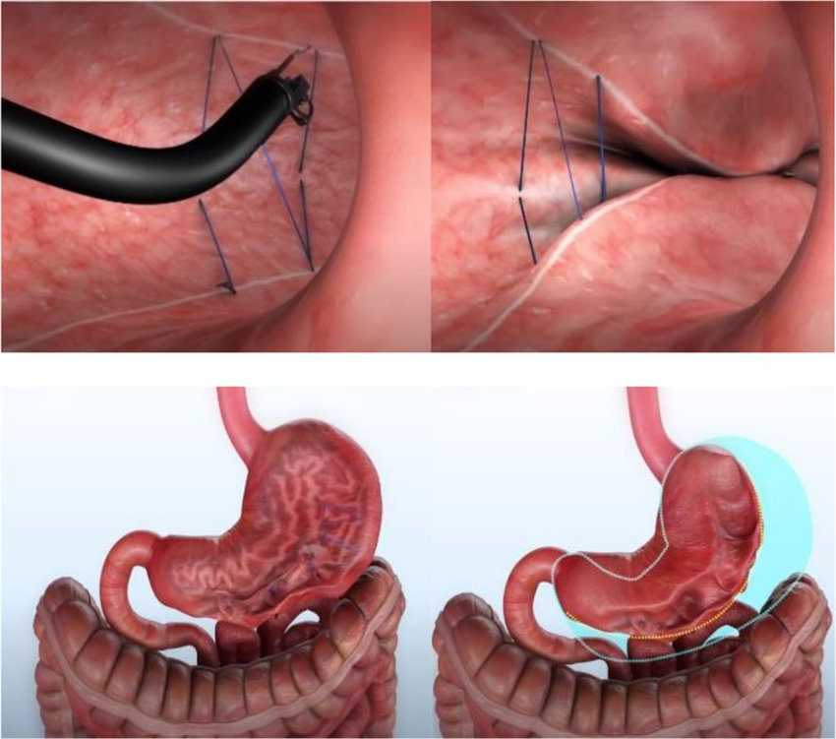
ENDOSCOPIC SLEEVE GASTROPLASTY
REVERSIBLE
MINIMALLY INVASIVE
ENDOLUMINAL
ORGAN SPARING
SAFE & EFFECTIVE procedure
(SAEs < 2%)
(TBWL 17-20% at two years)
Abu Dayyeh BK, Bazerbachi F, Vargas EJ, Sharaiha RZ, Thompson CC, Thaemert BC, Teixeira AF, Chapman CG, Kumbhari V, Ujiki MB, Ahrens J, Day C; MERIT Study Group; Galvao Neto M, Zundel N, Wilson EB. Endoscopic sleeve gastroplasty for treatment of class 1 and 2 obesity (MERIT): a prospective, multicentre, randomised trial.
Notes:
The need to develop procedures which are increasingly less invasive and less susceptible to adverse events, for the treatment of obesity, has led to the spread of bariatric endoscopy with particular exploit of endoscopic sleeve gastroplasty. Endoscopic sleeve gastroplasty (ESG) is a reversible, minimally invasive, endoluminal organ-sparing bariatric procedure that has gained widespread global adoption. It involves remodeling of the greater gastric curvature, using an endoscopic full-thickness suture device, with the objective of reducing gastric lumen and alter the motility of the stomach.

Slide 7
AIM OF THE STUDY
To assess the effectiveness of endoscopic revision (Re-ESG) versus primary intervention (P-ESG) focusing on weight loss outcomes.
Notes:
We conducted a retrospective analysis on a prospective dataset, including ESG procedures performed from

Slide 8
METHODS
Retrospective analysis of a prospective dataset (ESG May 2017- December 2023)
Comparisons between groups (baseline and follow-up data): statistical comparisons were performed with the use of Student’s t-test, after Shapiro wilk-test.

Slide 9
RESULTS
578 subjects underwent ESG
Number of patients | 578
Age (years) mean ± SD | 42.1 ± 9.1
BMI, mean ± SD | 37.9 ± 5.3
n= numbers of patients; BMI: Body Mass Index; SD: Standard Deviation.

Slide 10
RESULTS
578 subjects underwent ESG
53 patients (9.2%) underwent Re-ESG after a mean time of 25.4 ($±$11.4) months from P-ESG :
24 for Weigh Regain,
18 for Weight Plateau
12 for Weight Failure
One subject underwent a second revision, for a total of 54 revisions.
Number of patients | 53
Age (years) mean ± SD | 43.5 ± 9.6
BMI, mean ± SD | 35.5 ± 4.3
n= numbers of patients; BMI: Body Mass Index; SD: Standard Deviation.
Lopez-Nava G, Sharaiha RZ, Vargas EJ, et al. Endoscopic Sleeve Gastroplasty for Obesity: a Multicenter Study of 248 Patients with 24 Months Follow-Up. Obesity Surgery. 2017
Notes:
Out of a total of xx patients, 53 patients underwent Re-ESG: 24 for WR, 18 for WP and 12 for WF, after a mean time of 25.4 ($±$11.4) months from P-ESG. One subject underwent a second revision, for a total of 54 revisions.
Both P-ESG and Re-ESG were associated with significant total body weight loss, excess body weight loss and BMI loss up to 24 months (table 2).
Endoscopic revision was as effective as primary intervention in the short and medium term, as showed in table 3.

Slide 11
RESULTS
Overall weight loss outcomes after Re-ESG
Overall-ESG | n | Weight | p | AWL (kg) | EWL (%) | TBWL (%) | BMI (kg/m2) | p | BMIL (kg/m2)
6M | 29 | 85.2 (12.5) | <0.01 | 22.1 (11.8) | 60.9 (20.6) | 19.8 (7.1) | 30.5 (3.9) | <0.01 | 7.8 (4.1)
12M | 21 | 85.8 (15.4) | <0.01 | 22.9 (14.5) | 61.2 (20.3) | 20.4 (9.3) | 30.1 (3.6) | <0.01 | 8.2 (5.5)
18M | 10 | 91.7 (19.3) | 0.02 | 19.9 (13.3) | 52.5 (33.9) | 17.1 (10.0) | 32.1 (6.3) | 0.01 | 6.8 (4.5)
24M | 6 | 101.5 (26.4) | 0.536 | 16.2 (9.5) | 37.7 (19.6) | 13.1 (6.5) | 35.2 (8.7) | 0.402 | 5.4 (2.9)
A two sample T-Test was used to compare baseline weight and weight loss outcomes. ESG=Endoscopic Sleeve Gastroplasty; AWL=Absolute weight loss; EWL=Excess weight loss; TBWL=Total body weight loss; BMI=Body Mass Index; BMIL=BMI loss

Slide 12
RESULTS
 | 6-months |  |  |  | 12-months |  |  |  | 18-months |  |  |  | 24-months
 | AWL (kg) | EWL (%) | TBWL (%) | p | AWL (kg) | EWL (%) | TBWL (%) | p | AWL (kg) | EWL (%) | TBWL (%) | p | AWL (kg) | EWL (%) | TBWL (%) | p
P-ESG | 18.4 (7.9) | 55.2 (24.5) | 17.3 (6.7) | <0.01 | 17.9 (9.7) | 52.9 (27.7) | 16.7 (8.2) | <0.01 | 18.1 (10.5) | 50.0 (22.7) | 16.6 (8.3) | <0.01 | 16.3 (11.9) | 45.7 (32.7) | 15.1 (10.6) | <0.01
Re-ESG | 15.0 (7.7) | 52.9 (23.5) | 14.7 (6.1) | <0.01 | 17.0 (8.0) | 55.7 (21.8) | 16.5 (7.2) | <0.01 | 11.9 (10.9) | 41.4 (44.2) | 11.4 (11.0) | <0.01 | 7.3 (11.8) | 25.4 (25.9) | 7.0 (9.2) | 0.937
P | 0.32 | 0.571 | 0.434 |  | 0.712 | 0.684 | 0.924 |  | 0.121 | 0.569 | 0.128 |  | 0.122 | 0.183 | 0.109
Comparison of weight loss outcomes between primary ESG and endoscopic revision (Re-ESG) at 6-,12-,18- and 24-months follow-up.
Data are reported as mean value (standard deviation). A two sample T-Test was used to compare baseline weight and weight loss outcomes.;

Slide 13
CONCLUSION
Despite the limit of a low sample, our study highlights how the endoscopic revision of a previous ESG is as effective as the primary intervention in the short and medium term.
These results may pave the way for an exclusively minimal-invasive multi-step treatment of chronic obesity.

Slide 14
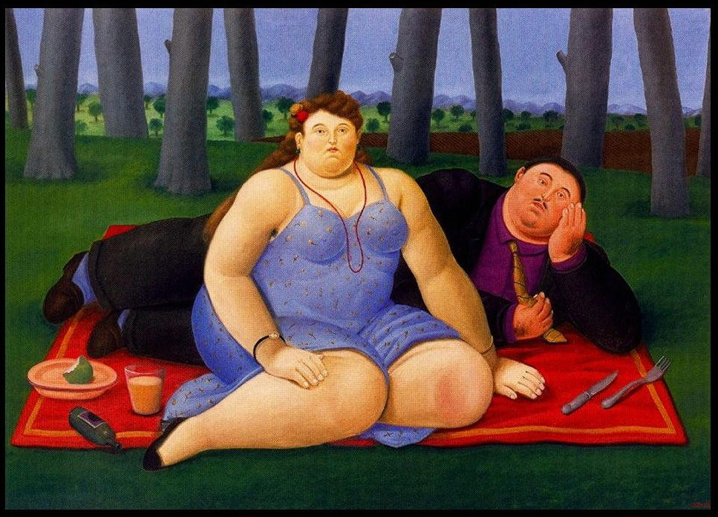
Grazie

